Slide 1
Embedded SoC Design
Group members: Adi Navale and Varsha Thirumalai

Slide 2
TIC-TAC-TOE Game Overview
Will incorporate hardware from previous labs
VGA – for display
GPIO – Input a game reset interrupt
Memory – Store software instructions written in C/Assembly
Cortex M0 Processor – Execute instructions
Cortex-M0 Processor
VGA
Memory
GPIO

Slide 3
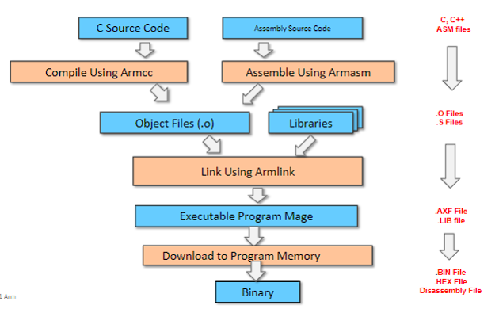
Software Overview
Will incorporate both assembly and C
C for efficient development
Assembly for greater control of hardware registers

Slide 4
C Language
C Language
Create logic of tic-tac-toe game
Modify or create C functions from previous labs
For example:
VGA_plot_pixel
Create diagram of tic-tac-toe
Place X and Os

Slide 5
Assembly Language
Enable interrupts
Toggled by switch on FPGA configured in hardware
Change color of pixel colors displayed

Slide 6





Workflow

Slide 7
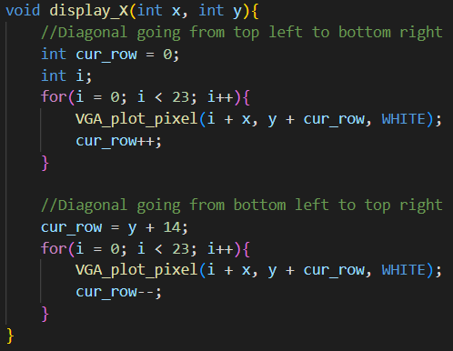
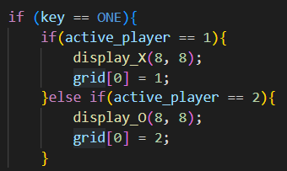
Display APIs Created
Created APIs to display X and O on the tic-tac-toe grid
API code
Use of API in main.c

Slide 8
Game Logic
Utilized an integer of arrays to represent tic-tac-toe grid
When a player plays the values in grid are updated
Utilized active_player variable to track who is playing

Slide 9

Game Logic
Displays X or O and updates grid when a player plays

Slide 10
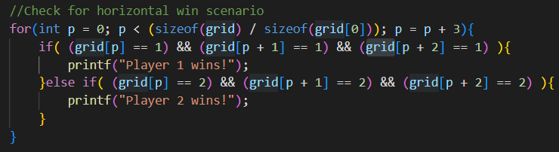
Game Logic
A for loop checks the grid to determine if a player has won

Slide 11
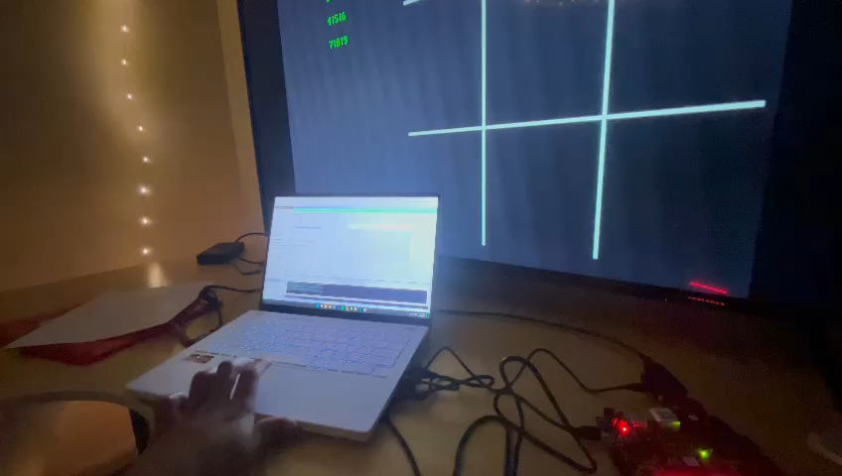

Slide 12
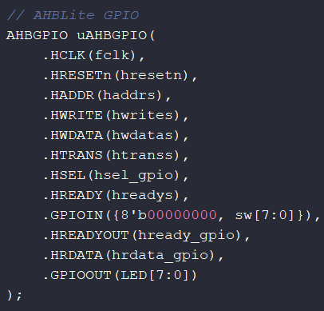
Further Work
AHBLITE.SYS
Keyboard inputs via Tera Term will be replaced by buttons on FPGA
Update constraint file
Map inputs to GPIO in hardware

Slide 13
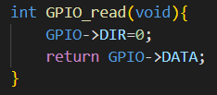
Further Work
Utilize GPIO read hardware driver
Update main.c to track user inputs

Slide 14
Questions

